Slide 1
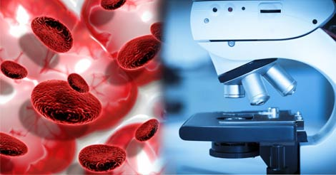
Blood Cancer Detection Using Microscopic Images

Slide 2
CONTENTS
Motivation
Introduction
Problem Statement
Literature Survey
Existing Methods
System Flow

Slide 3
Motivation
The main motto of this work is to detect the Leukaemia at earlier stage with the help of Image Processing techniques.
Leukaemia means blood cancer which is featured by uncontrolled and abnormal production of white blood cells(leukocytes) by the bone marrow in the blood.
Acute Lymphoblastic Leukaemia(ALL) is a type of Leukaemia which is more common in children due to its non specific nature of the symptoms and signs of ALL leads wrong diagnosis.
Even haematologist finds it difficult to classify the Leukaemia cells, there manual classification of blood cells is not only time consuming but also inaccurate therefore early identification of Leukaemia yields in providing the appropriate treatment to the patient.
And it is very necessary to detect cancer in the early stages to treat this type of cancer or any type of cancer.

Slide 4
Introduction
Blood Cancer, also known as hematologic cancer, typically starts in the bone marrow and then begins to affect blood cells but it can take on a variety of forms.
Leukemia means blood cancer which is featured by uncontrolled and abnormal production of white blood cells(leukocytes) by the bone marrow in the blood.
Leukemia is detected only by analyzing the white blood cells. So our study is focused only on white blood cells(WBCs).
Leukemia is grouped in two ways according to how fast the cells are growing : acute or chronic.

Slide 5
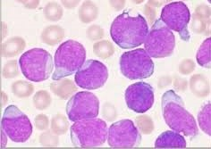
Introduction (cont.)
As in acute leukemia, if the treatment is not done in a precise time, the person will die within a few months.
There are four major forms of leukaemia. They are:
Acute lymphoblastic leukaemia (ALL)
Acute myelogenous leukaemia (AML)
Chronic lymphocytic leukaemia (CLL)
Chronic myelogenous leukaemia (CML)
Acute

Slide 6
Problem Statement
Identification of blood disorders is practiced by visualization of blood samples through a microscope by the naked eye of the human. In this work a computerized technique has been developed to help the doctor in identifying different types of Leukemia.
Initially, the RGB image is converted to L*a*b color space and is segmented using K-means clustering. To this clustered image the features are extracted and the classified into different types of Leukemia.
The required code is developed using the TensorFlow. A graphical user interface will be developed for a better understanding of procedure. This technique is used to identify the diseases and diagnose them at early stage. Images are used as inputs, as they are cheap and do not need any kind of expensive testing nor lab equipment. This work will be using the features in microscopic images and examine any kind of changes on color, texture, geometry and statistical analysis of the images. The changes that are found in this features will be used as our classier input.

Slide 7
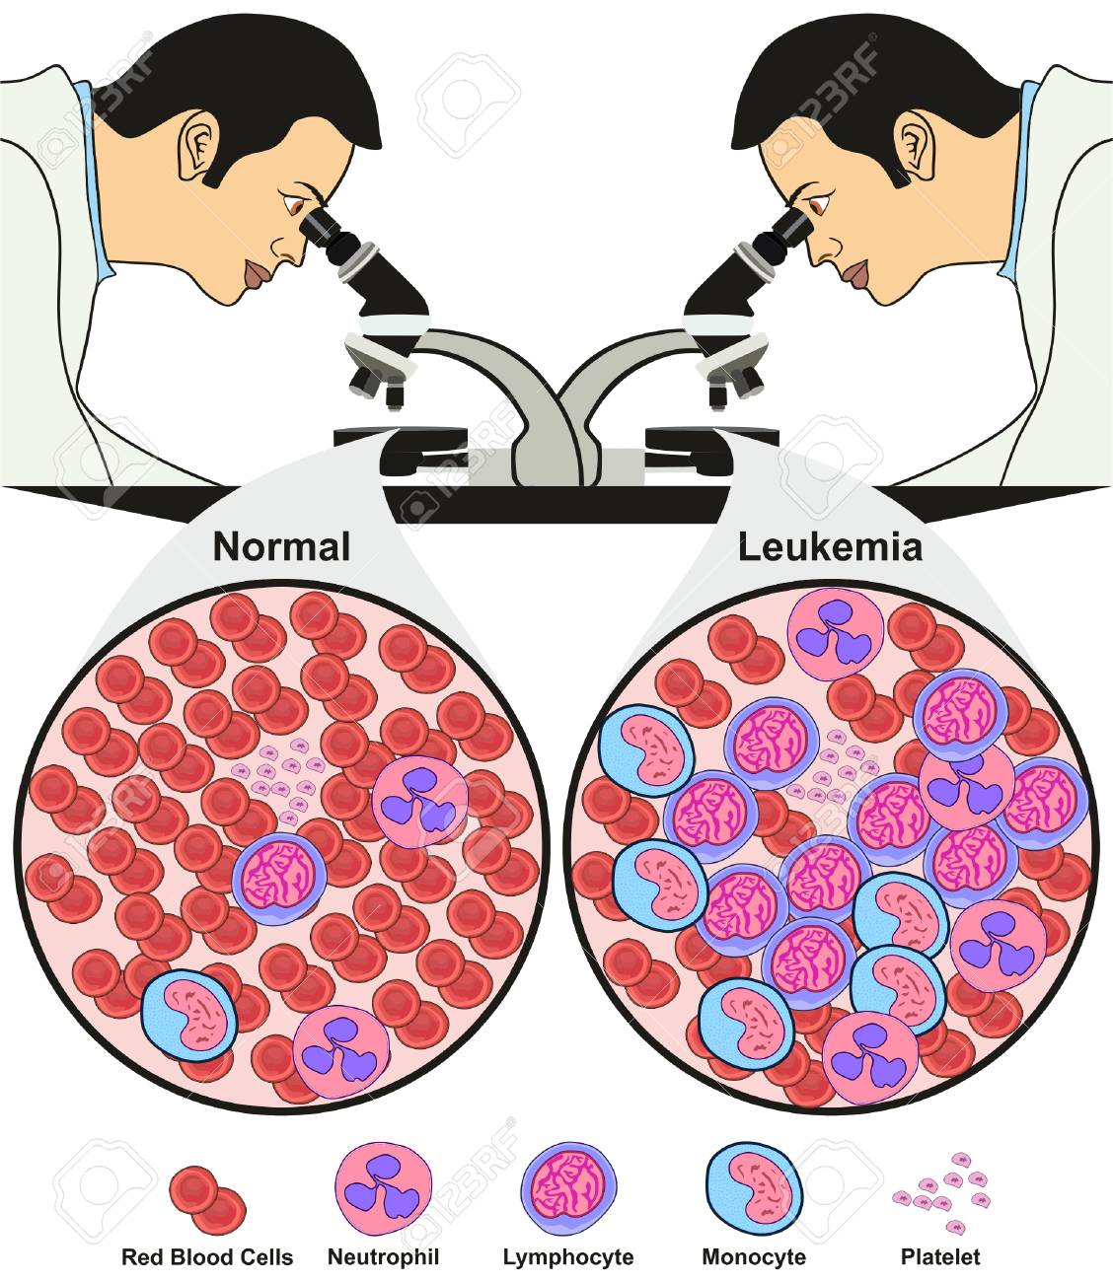
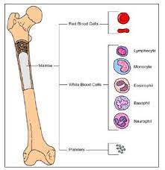
Bone Marrow

Slide 8
Literature Survey
Survey - I :
The paper “Robust segmentation and measurements techniques of the white cells in blood microscopic images” by Scotti is based on the white blood cell segmentation clustering and removal of background
Technologies Used : Threshold operations and low-pass filters.
Features : Automatic identification of leukocytes is performed from the microscopic images.
Limitations : The adjacent leukocytes segmentation phase may be affected.

Slide 9
Survey - II
The paper “Automated leukocyte recognition using fuzzy divergence” by ghosh deals with finding out the accurate threshold for the leukocyte segmentation.
Techniques Used :
Fuzzy divergence technique, Gamma, Gausian, Cauchy techniques.
Features : Recognition of leukocyte and modification of thresholding is carried out.
Limitations: Better recognition may be obtained when more thresholding is done in images

Slide 10
Survey - III
The paper ”An automated white blood cell localization and segmentation using image arithmetic and automatic threshold” by Madhloom HT, Kareem SA, Ariffin H, Zaidan AA, Alanazi HO, Zaidan BB, states that the white blood cell nuclei can be detected by using some image arithmetic operation and some image threshold operations
Techniques Used : Image arithmetic operations , Image threshold operation
Features: Nucleated cells are analyzed, remaining components are removed and blood cells are automatically recognized from the samples
Limitations : White blood cells should be localized from large number of data sets.

Slide 11
Survey - IV
The paper, “Detection of Acute Leukaemia using White Blood Cells Segmentation based on Blood Samples”, by Ms.Minal D.Joshi, Prof.A.H.Karode, represents the image segmentation for the blood sides and then the classification for the automatic leukaemia detection.
The paper states that the features of an image such as the perimeter, circularity, area etc., are calculated using the feature extraction method. The normal cell and the blast cells are differentiated using the pattern recognition. The KNN classifier is used for the calculation of features such as the circularity, area, perimeter, etc.
Techniques Used :
Image segmentation , Classification,
Features extraction, pattern recognition ,KNN classifier
Limitations : The output can be improved by the cost effective and robust automated system for the screening of Leukemia

Slide 12
Existing System
From the Literature Survey we have noticed that :
The adjacent leukocytes segmentation phase may be affected.
Better recognition may be obtained when more thresholding is done in images.
Some white blood cells should be localized from large number of data sets.
There are some outputs that can be improved by the cost effective and robust automated system for the screening of Leukemia.

Slide 13
Proposed Work
Various techniques have been developed by researchers to detect leukemia. One of the most used technique is Convolution Neural Network (CNN) It is based on computer vision in recent years.
The differentiation of the leukocytes, the types of leucocytes may be segmented and identifies by this algorithm.
There are a lot of algorithms that people used for image classification before CNN became popular.
CNNs can be thought of automatic feature extractors from the image. While if we use a algorithm with pixel vector we lose a lot of spatial interaction between pixels, a CNN effectively uses adjacent pixel information to effectively down sample the image first by convolution and then uses a prediction layer at the end.

Slide 14
Existing Methods
Medical history and physical examination : The record of present symptoms, and problems a person has had in the past. The medical history of a person’s family also helps in diagnose leukemia.
Complete blood count (CBC) : Blood is taken and checked under the microscope for the number of RBCs, WBCs and platelets.
Bone marrow aspiration: Bone marrow is removed with the help of a needle from breastbone. The removed sample is observed under a microscope to look for abnormal cells.
Cytogenetic analysis: Cytogenetic test takes blood or bone marrow to help identify individual chromosomes. It shows abnormalities in chromosomes, which help to diagnosis and identify the type of leukemia. Results are usually available within 3 weeks.

Slide 15
System Flow
Classification using CNN
Image Dataset
Image Pre-processing
Features Extraction
Cancer
Normal
Image
Pre-Processing
Test Image
Feature Extractions using CNN

Slide 16
Dataset
Images used in this project were obtained from Kaggle dataset which is a public dataset available online.
This dataset was divided into 2 classes.
In total there are 15,135 images from 118 patients with two labelled classes:
1. Normal cell
2 .Leukemia blast.
The task of identifying immature leukemic blasts from normal cells under the microscope is challenging due to morphological similarity and thus the ground truth labels were annotated by an expert oncologist.

Slide 17

THANK YOU
B.Harish
M.Hemalata
P.Pranaya Durga
B.Rhema Sravya
Guided by : Dr. P. Aruna Kumari

